Slide 1
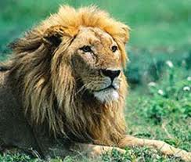
Flora and fauna in INDIA
Made by sana junaid

Slide 2
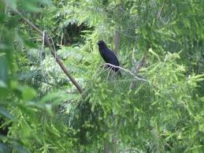
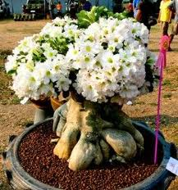
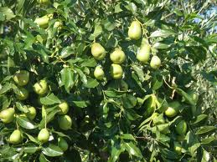
FlORA
47000 species are found in india
Of the estimated 47000 plant species ,about 15000
Flowering are endemic to india

Slide 3
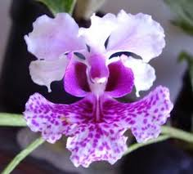
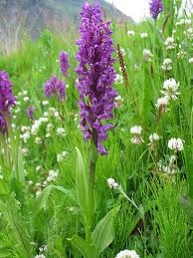
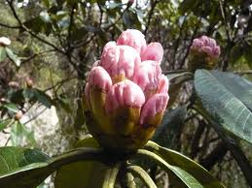
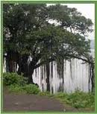

Slide 4
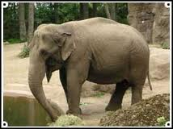
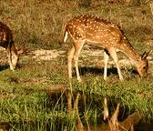
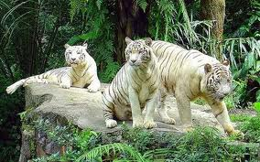
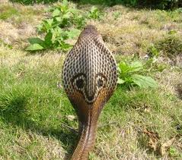
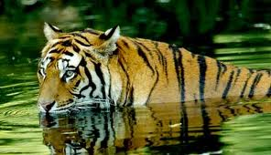
FAUNA
INDIA HAS ABOUT
81,000 SPECIES OF FAUNA

Slide 5
Some of the estimations have told that 10 percent of recorded wild flora and 20 percent of its mammal life are threatened.
Many of them have been now at the verge of extinction.
FACT :-
79 species of mammals ,44 of birds 15 of reptiles and 3 of amphibians are threatened
While ,1500 plants are considered endangered.
Made by anjali

Slide 6
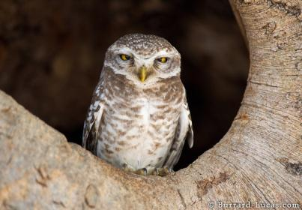
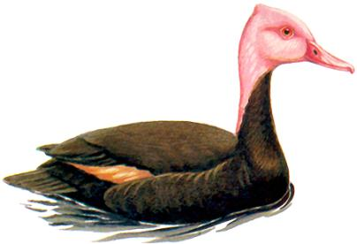
Animals at the verge of extinction…….

Slide 7
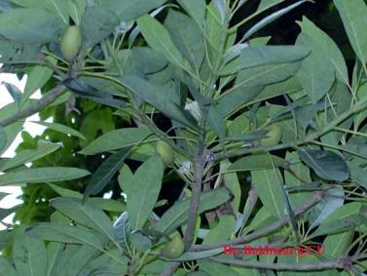
Some plants which are at the verge of extinction :
Madhuca insignis
Hubbardia
heptaneuron

Slide 8
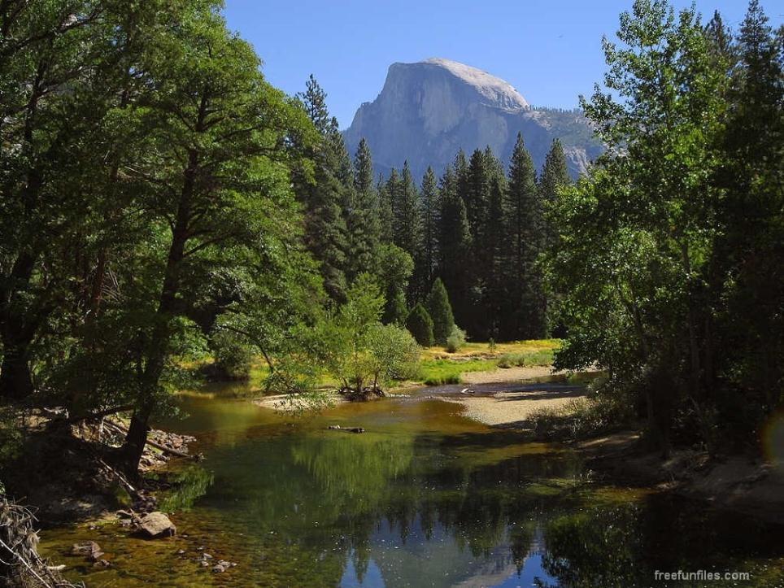
VANISHING FORESTS
VANISHING FORESTS
The dimensions of deforestation in India are unsteadily increasing . The forest cover is estimated to be 637,293 , that is 19.39 per cent of the total geographical area.
(Dense Forest – 11.48 , Open Forest – 7.76 , mangroves – 0.15 per cent).
According to the State of Forest Report the dense forest has increased by 10,098 sq km since 1997. This forest cover increase is due to plantation by different agencies.

Slide 9
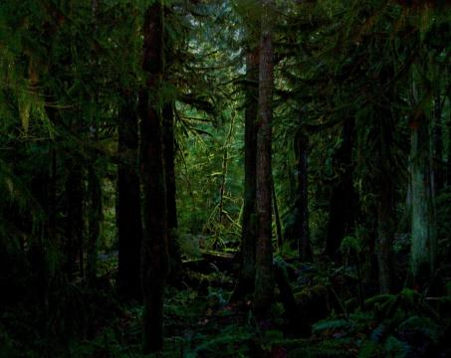
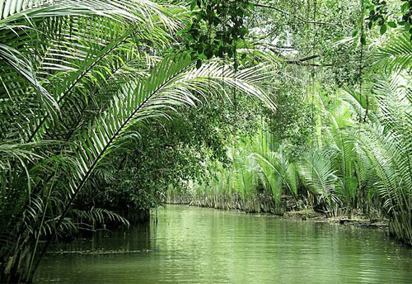
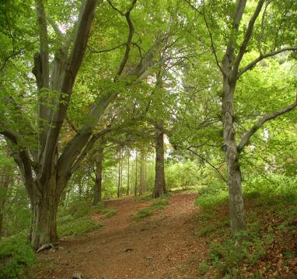
OPEN
FOREST
MANGROVE
DENSE
FOREST

Slide 10
Forest & Wildlife Resourses

Slide 11
Normal Species
Normal Species:
Species whose population levels are considered to be normal for their survival.
Examles of normal species:
Cattle
Rodents
Pine
Crocodile
Indian Rhino

Slide 12
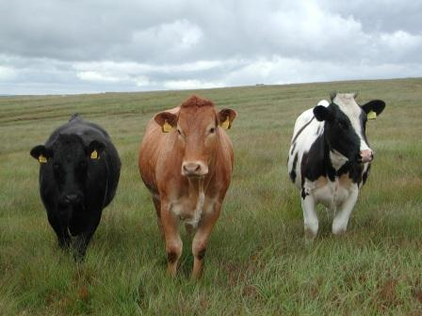
Cattle
Cattle

Slide 13
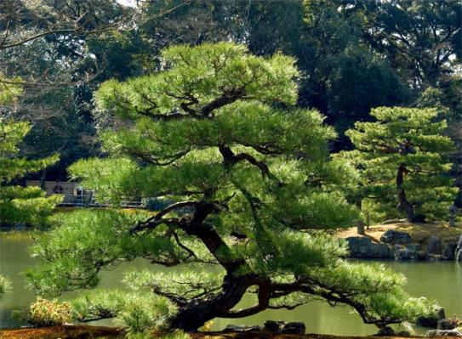
Pine

Slide 14
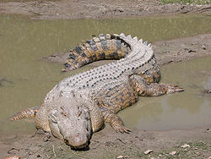
Pine
Crocodile
Pine

Slide 15
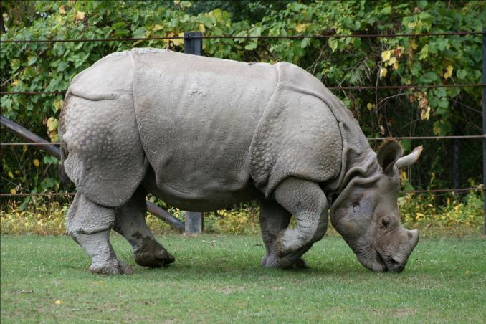
Indian Rhino

Slide 16
ENDAGERED
SPECIES

Slide 17
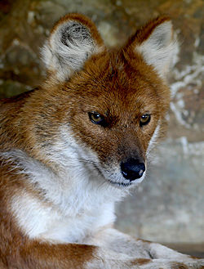
Endagered Species
* Endangered Species is the population of organisms
which is at risk of becoming extinct because it
is either few in numbers, or threatened by changing
environmental or predation parameters.
* The survival of these species is difficult if their
negative factors that have led to a decline in their
population continue to operate.
Most Endangered Asiatic Dhole is on the edge of extinction.

Slide 18
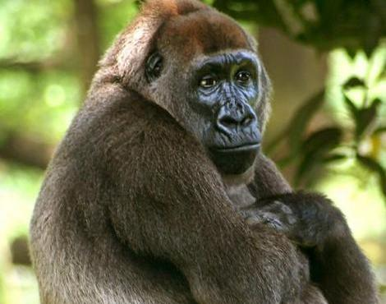
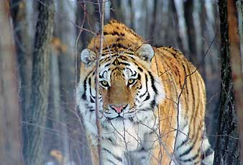
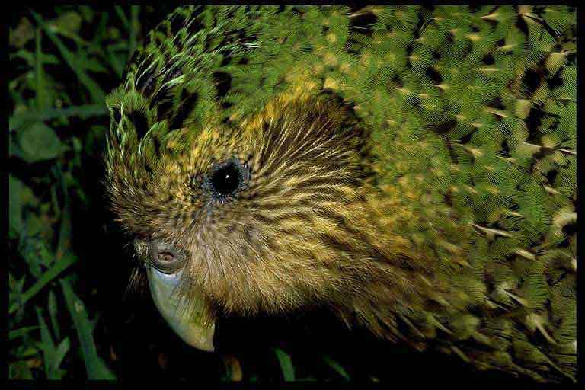
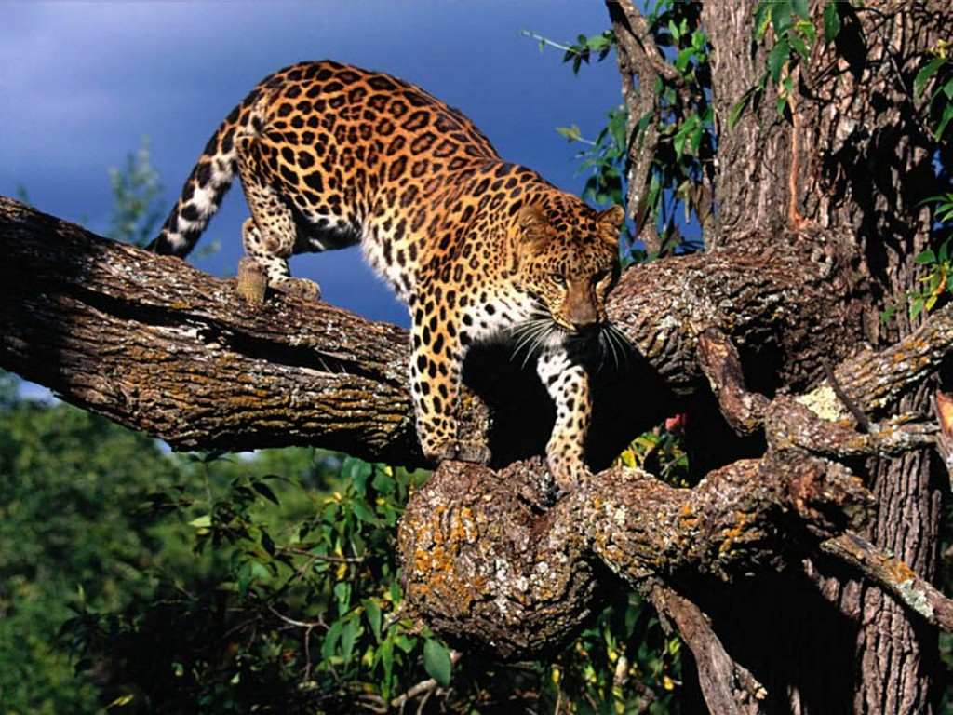
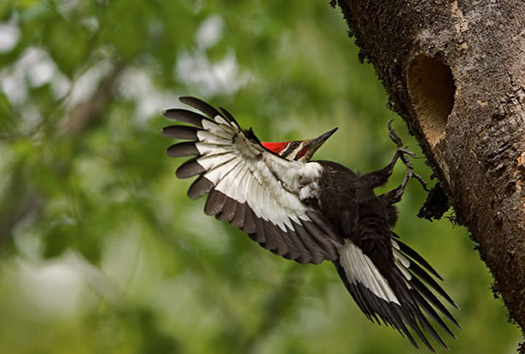
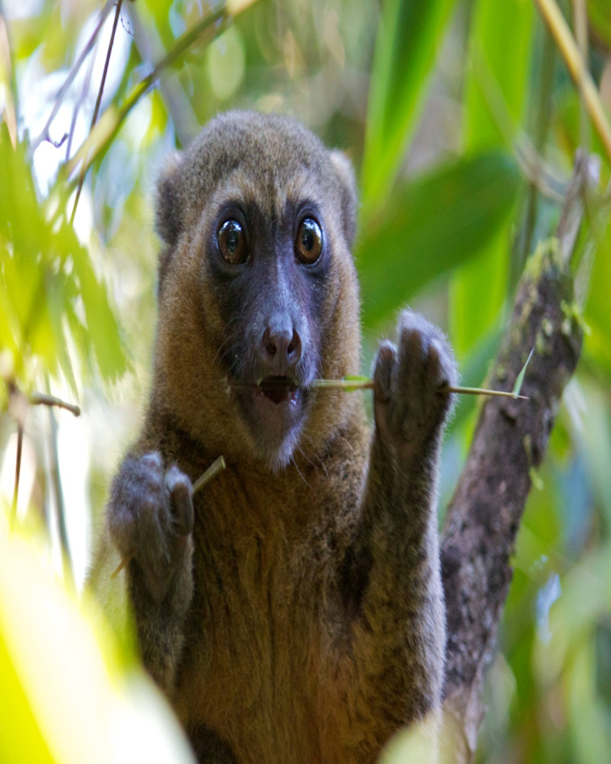
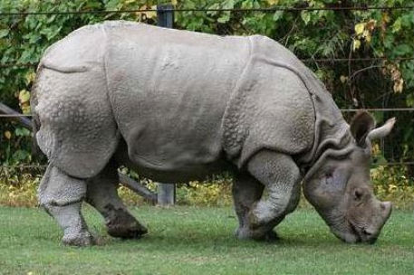
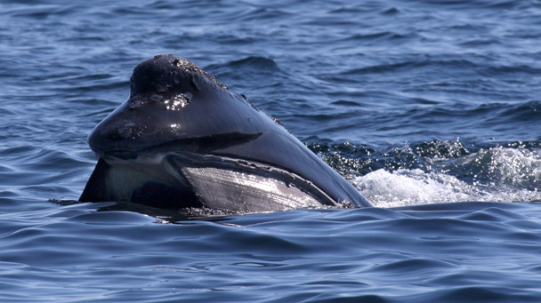
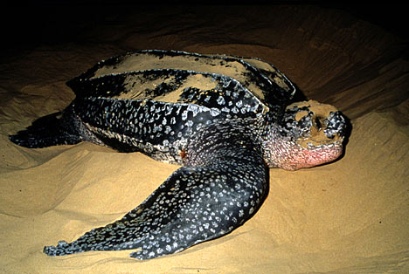
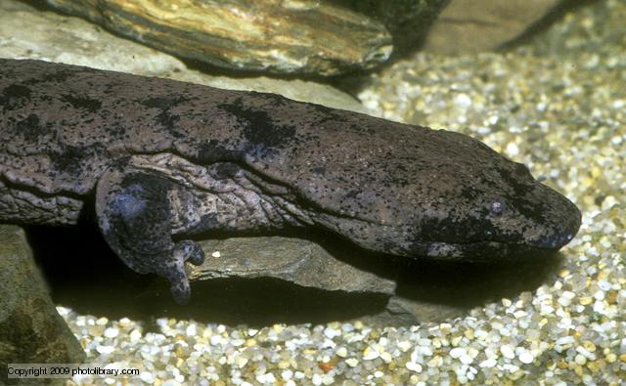
10 Most Endangered Species :
5. Northern Right Whale
6.Cross River Gorilla
7. Leatherback Sea Turtle
9. Chinese Giant Salamander
8. Amur Tiger
10.Kakapo Parrot
1.Ivory- Billed Woodpecker
2. Amur Leopard
3. Javan Rhinoceros
4. Greater Bamboo Lemur

Slide 19
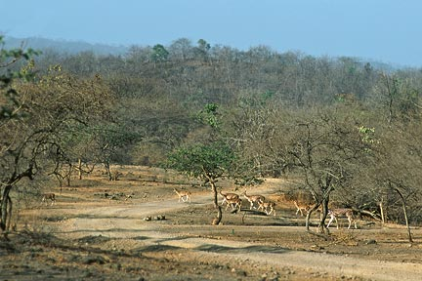
VULNERABLE SPECIES.

Slide 20
These are those type of species whose population has declined to the levels which it is likely to move under the category of the endangered species.

Slide 21
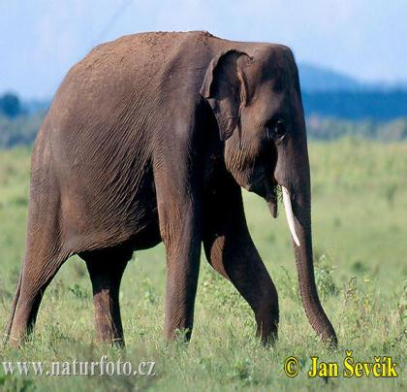
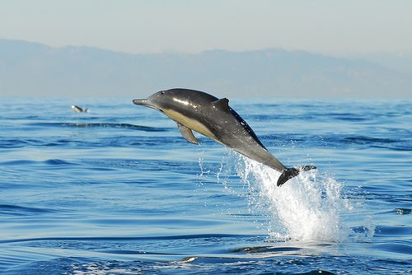
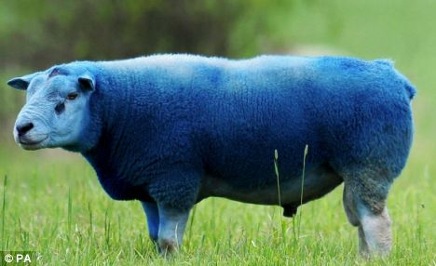
EXAMPLES:
Asiatic elephant
Gangetic Dolphin
Blue sheep

Slide 22
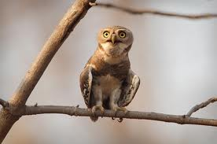
Endemic Species
A species which is only found in a given region or location and nowhere else in the world.
Some Examples are: Forest Owlet

Slide 23
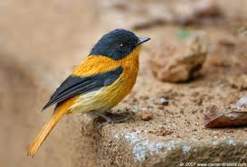
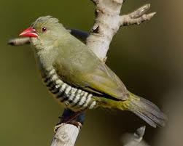
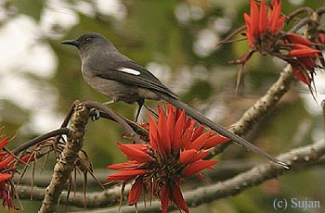
Black-and-Rufous Flycatcher
Green Avadavat
Snowy-Throated Babbler

Slide 24
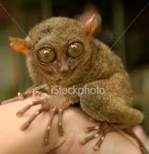
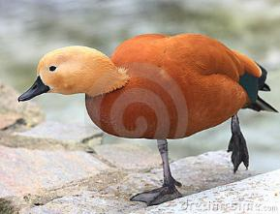
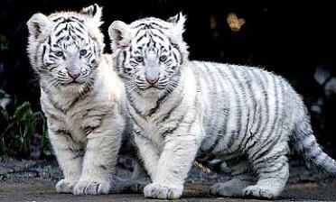
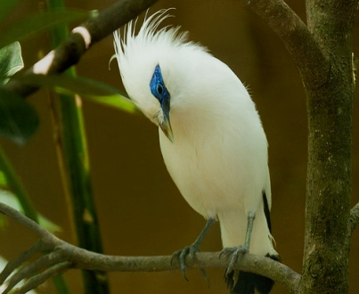
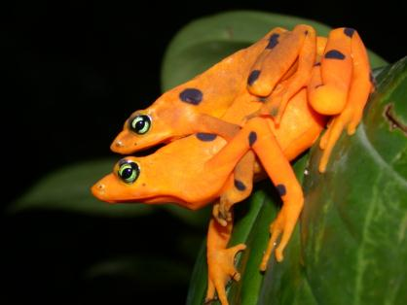
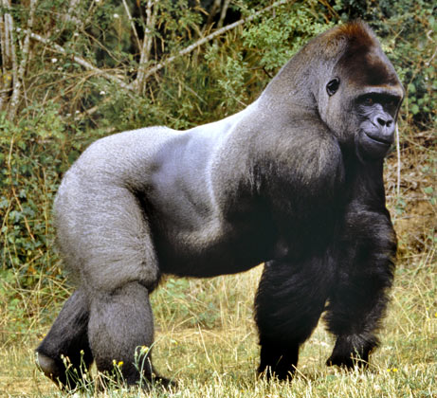

Slide 25
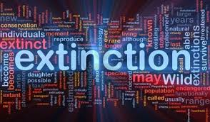
By ashwarya .pattni

Slide 26
Extinct species
A species becomes extinct when the last existing member dies. Extinction therefore becomes a certainty when there are no surviving individuals that are able to reproduce and create a new generation. A species may become functionally extinct when only a handful of individuals survive

Slide 27
Species listed under this status by the International Union for Conservation of Nature (IUCN) are not known to have any living specimens in the wild, and are maintained only in zoos or other artificial environments.
The extinction of one species wild population can have knock-on effects, causing further extinctions. These are also called "chains of extinction".^{[10]} This is especially common with extinction of keystone species.

